Slide 1
Past State Planning Initiatives Regarding
Sears Island and Mack Point
SUMMARY
Sears Island Planning Initiative (SIPI)
Steering Committee Consensus Agreement
April 2007
Joint Use Planning Committee (JUPC)
Final Report and Recommendations for Implementation
2008

Slide 2
SIPI
Consensus Agreement
April 2007
SECTION 1
(p.1)
Mack Point (MP) & Sears Island (SI)
Appropriate Uses
  Compatibly Managed
        Marine Transportation
        Recreation
        Education
        Conservation

Slide 3
SIPI
Consensus Agreement
SECTION 1
(p.2)
Sears Island: Inappropriate Uses & Activities
No demolition of the causeway | No overnight camping without a permit
No unauthorized motor vehicle traffic | No gate fees for Maine residents
No residential development | No permanent religious buildings
No nuclear power plants | No unauthorized cutting or harvesting of wood
No coal-fired power or industrial plants | No marine transport of out-of-state or domestic garbage or construction waste to or from the island
No commercial retail or restaurants | No incinerator
No casinos | No unlawful destruction of wetlands or habitat
No chemical manufacturing | No soil harvesting
No international airport, airstrip or helicopter landing area

Slide 4
SIPI
Consensus Agreement
SECTION 2
(p.2)
Mack Point (MP)
Buildout of Mack Point:
“Mack Point shall be given preference as an alternative to port development on Sears Island.”

Slide 5
SIPI
Consensus Agreement
SECTION 2
(p.2)
Mack Point (MP)
MaineDOT :
  Investigate MP for marine transportation needs (with others)
    -additional acreage and pier construction
  Collaborate to evaluate a cargo/container port at MP and/or SI
  Actively pursue proposals and partnerships for cargo/container port on MP & SI

Slide 6
SIPI
Consensus Agreement
SECTION 3
(p.3)
Recreation, Education, Conservation-SI
Create Buffer Easement for outdoor recreation, education, conservation
Conservation Easement granted by MaineDOT to Maine Coast Heritage Trust (Jan. 2009):
  Perpetual
  601 Acres on SI (Protected Property)
  Protects natural, undeveloped character of land
  Includes wetland mitigation area
  Allows low impact outdoor recreation & education & related facilities
  Maine Department of Environmental Protection Enforcement
  Remaining 333 acres not included in Conservation Easement is Transportation Parcel
Notes:
Book 3289, P 300

Slide 7
SIPI
Consensus Agreement
SECTION 4
(p.4)
Cargo Port Permitting
No advance endorsement of any marine transportation facility
No opposition for non-substantive reasons
No opposition to SI cargo/container port if:
  Meets environmental/regulatory requirements
  Alternatives Analysis shows other locations do not meet need
  Reserved right to object to LNG or oil Terminal

Slide 8
SIPI
Consensus Agreement
SECTION 5
(p.4-5)
Expectations of MaineDOT
Jurisdiction of SI with MaineDOT. MaineDOT to collaborate with Searsport and interested parties to implement Consensus Agreement to:
Meet Maine’s Transportation needs
Enhance opportunities for Eco-Tourism
Generate revenue for Searsport and region
Comply with buffer easement

Slide 9
JUPC
Final Report
2008
JUPC Tasks
Propose methods to compatibly manage conservation, education, recreation, & transportation on MP & SI
  Identified and established locations for:
    Protected Property
    Potential Education & Maintenance Center Area
    Cell Tower Lease Acquisition
    Enhancement/Restoration Areas
    Transportation Parcel

Slide 10
JUPC
Final Report
JUPC Tasks
Define Boundaries: Transportation Parcel & Protected Property:
  Action: Adopted Boundary Map :
Transportation Parcel: 330 acres; 11,514 feet of shoreline
Cell Tower Lease: 5 acres
Protected Property: 601 acres; 19,290 feet of shoreline
Develop buffer (Conservation) Easement
  Action: Executed Easement for Protected Property in January 2009.
  Holder: Maine Coast Heritage Trust

Slide 11
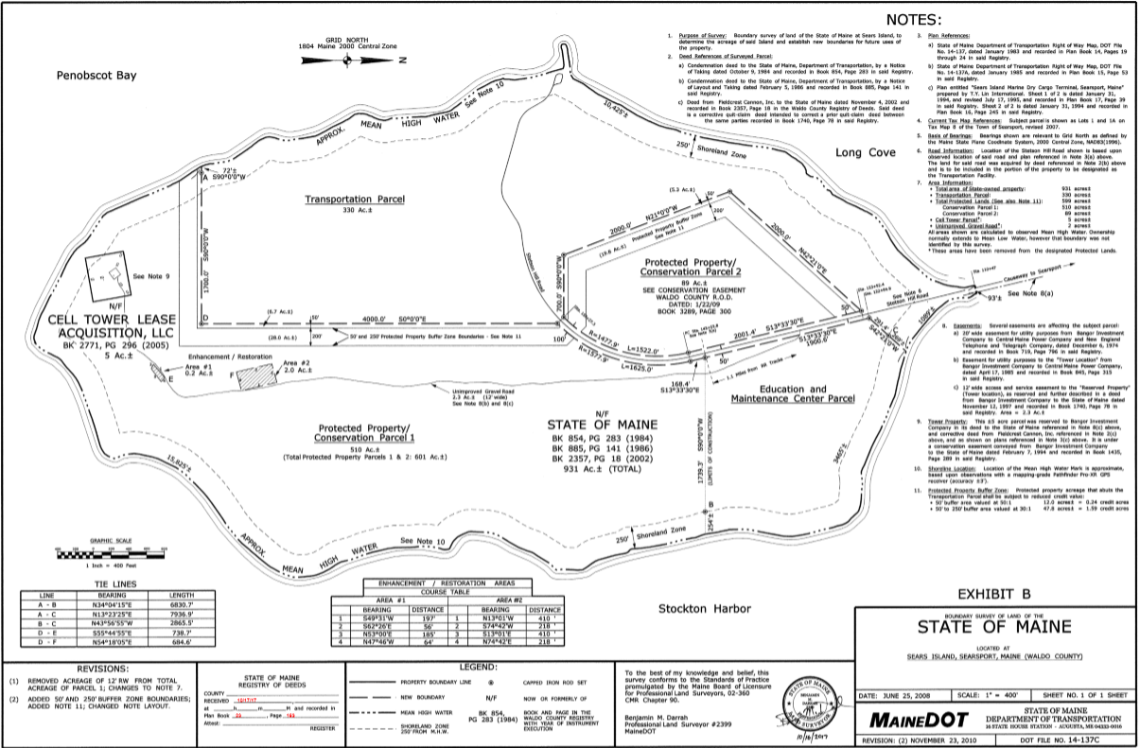
JUPC
Final Report
BOUNDARIES

Slide 12
JUPC
Final Report
(Rec. #2, p.8)
Transportation Parcel Location
330 acres
Primary Factors
  Orientation to existing federal navigation channel
  Site topography to accommodate rail service
Secondary Factors
Wetlands, vernal pools, endangered species
Coastal bird and shellfish habitat, eelgrass

Slide 13
JUPC
Final Report
(Rec. #2, p.8)
Protected Property Location
601 acres
Considerations
      Existing trail network
      Views from certain vantage points
      Important natural beach
      Natural resources
      Access
      Land suitable for visitor orientation area

